Slide 1
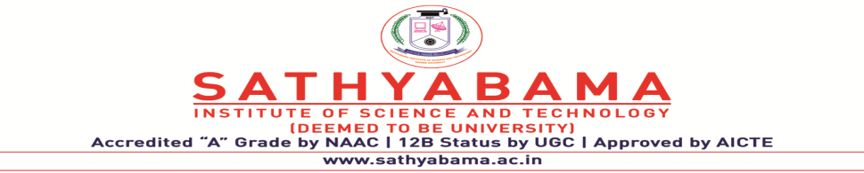
House Rent Prediction
Project Supervisor: Ms. Lakshmi Priya
Name of the Student: Mr. Ravipati Abhiram
Register Number: 39110840

Slide 2
Presentation Outline
Introduction
Objectives
System Architecture / Ideation Map
Module Implementation
Project Implementation
Methodology
Results and Discussions
Analysis and Interpretation of Results
Conclusion & Future work
References

Slide 3
Introduction
People looking to rent a house tend to be more conservative with their budgets and priorities.
There are several factors that affect the rental cost of the house such as location, maintenance cost, property size, etc.
This system proposes a performance comparison between two machine learning regression algorithms.
The functioning of this project involves a website which accepts customer’s specifications and then uses the prediction model to predict the house rent. The system will return the predicted house rent to the customer based on the specifications the customer gives.

Slide 4
Objective
Renting a house in a big city like Hyderabad is an hectic process.
As the customer has to roam places and has to pay commission to the real estate agent. There is no guarantee that the customer gets insights according to his specifications.
So, we are creating this house rent predictor through which the customer can predict the house rents by providing the specifications he/she wants.

Slide 5
Scope
The main scope of this prediction is to analyze the Hyderabad House Rents dataset using machine learning libraries to make some useful predictions. These analyses will give deeper insight into the house rents of Hyderabad city and helps people to analyze the rents based on different parameters.
We are going to achieve the objective by performing various processes like cleaning, analyzing, feature engineering, outliner detection, one hot encoding the data. Then the data is split into training and testing data sets and apply machine learning algorithms to predict the house rent.

Slide 6
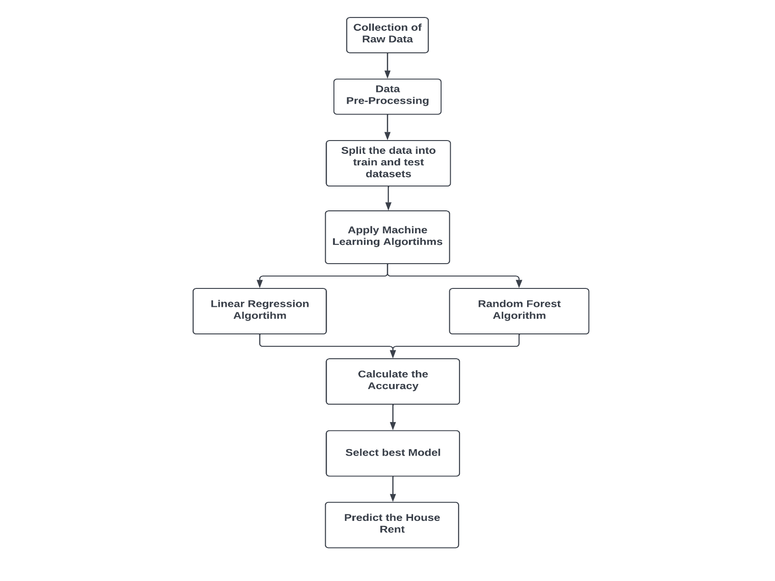
System Architecture / Ideation Map

Slide 7
Module Implementation
This Project contains 3 modules:-
Machine Learning Model ( Data Collection, Data Pre-Processing, Training and Testing the Model, Finding the Accuracy).
Back-end using Flask
Front-end using HTML, CSS, JavaScript

Slide 8
Project Implementation
Hardware and Software Requirements:-
x86 64-bit System
4 GB RAM
5 GB free disk space
Software Requirements:-
Python
Jupyter Notebook
Visual Studio Code

Slide 9
Project Implementation
Libraries Used:-
Numpy
Pandas
Matplotlib
Scikit-learn
Pickle
Json
Flask

Slide 10
Methodology
1) Data Collection:
The first step in any kind of Machine Learning Project is Data Collection. In order to make anu prediction model.
We need large amount of data on which we can apply various techniques to reach to a particular conclusion.
It is advised to take large amount of data because, larger the data greater the accuracy in the result.
We have taken the dataset from Kaggle which contains the data of Hyderabad Houses.

Slide 11
Methodology
2) Data Pre-Processing:
The second step after collecting Data is Data Processing. Data directly obtained from a data source such as dataset is known as Raw data.
Raw data can’t be used directly for visualization, so the data needs to be processed and converted into useful data. Data Pre Processing is the process of translating the Raw data into Useful data by conscientiously checking for errors and eliminating redundant, incomplete, or incorrect data.
The columns which are not helpful in predicting are removed. If any of the columns contain null values those null values are needed to be omitted or replaced with some valid value like mean of the data in that particular column. After that, feature engineering must performed to transform raw data into features that can be used in supervised learning. Then, Outlier detection must be done on the data.
After the outlier detection, One hot encoding must be done to convert categorical variables into a form that could be provided to ML algorithms to perform better.

Slide 12
Methodology
3) Training and Testing the Model:
The next step after data pre-processing is creating the ML model for prediction. First, the data must be split into train and test data sets.
The train data set contains 80% data and the test dataset 20%. Then it should be fit into the algorithm.
We used two algorithms in this project, Linear Regression and Random Forest.
We got 86.5 % accuracy with linear regression algorithm and 85.3 % accuracy with random forest algorithm. So, we choose linear regression model to predict the house rents.

Slide 13
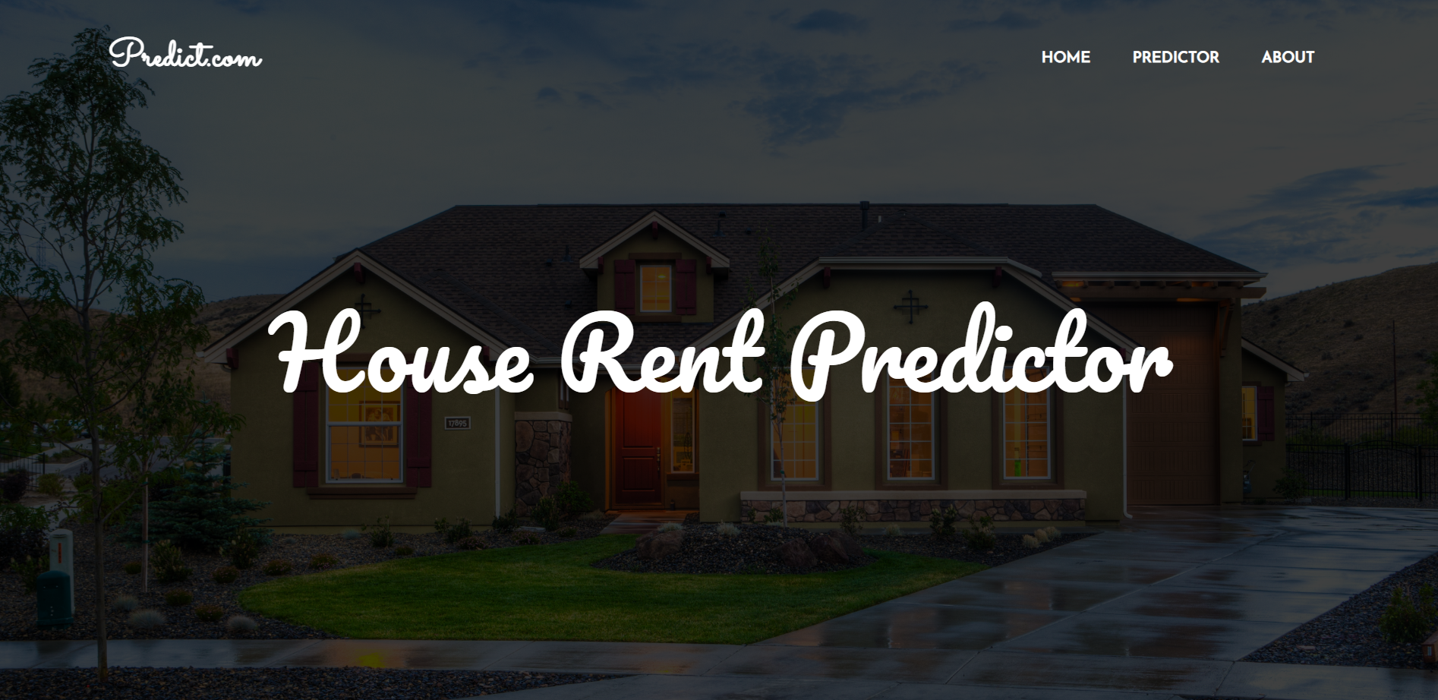
Results and Discussion

Slide 14
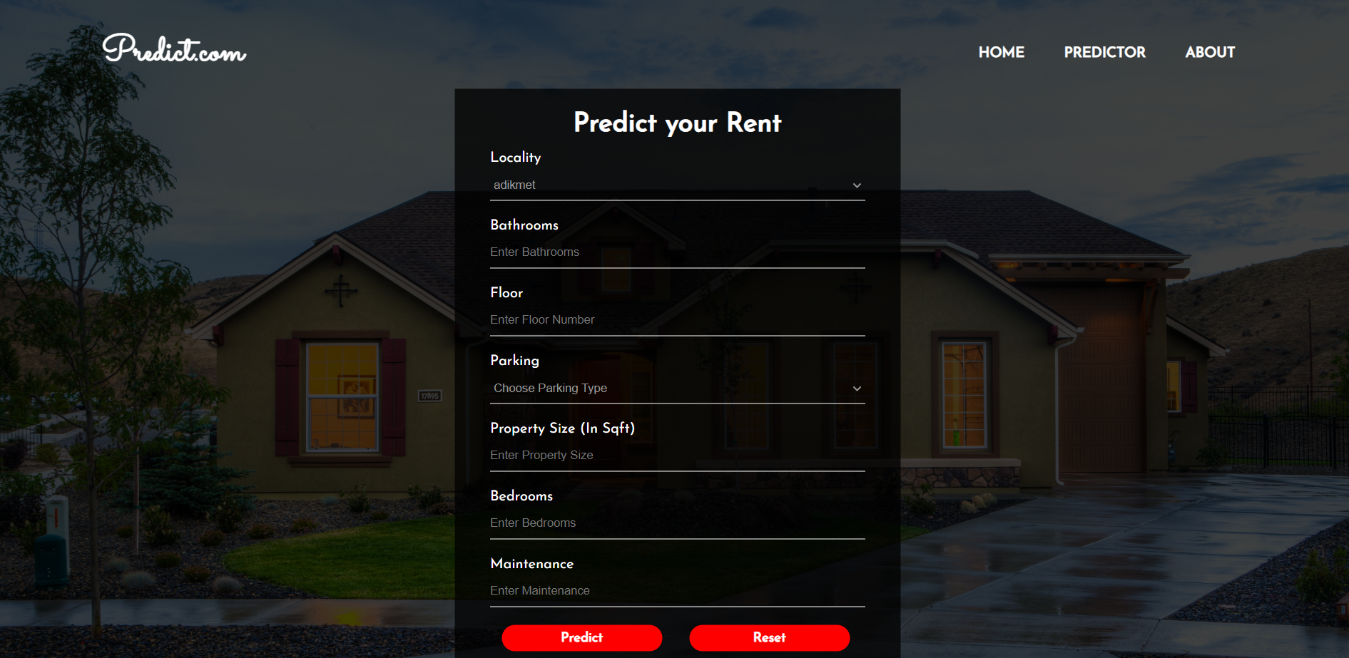
Results and Discussion

Slide 15
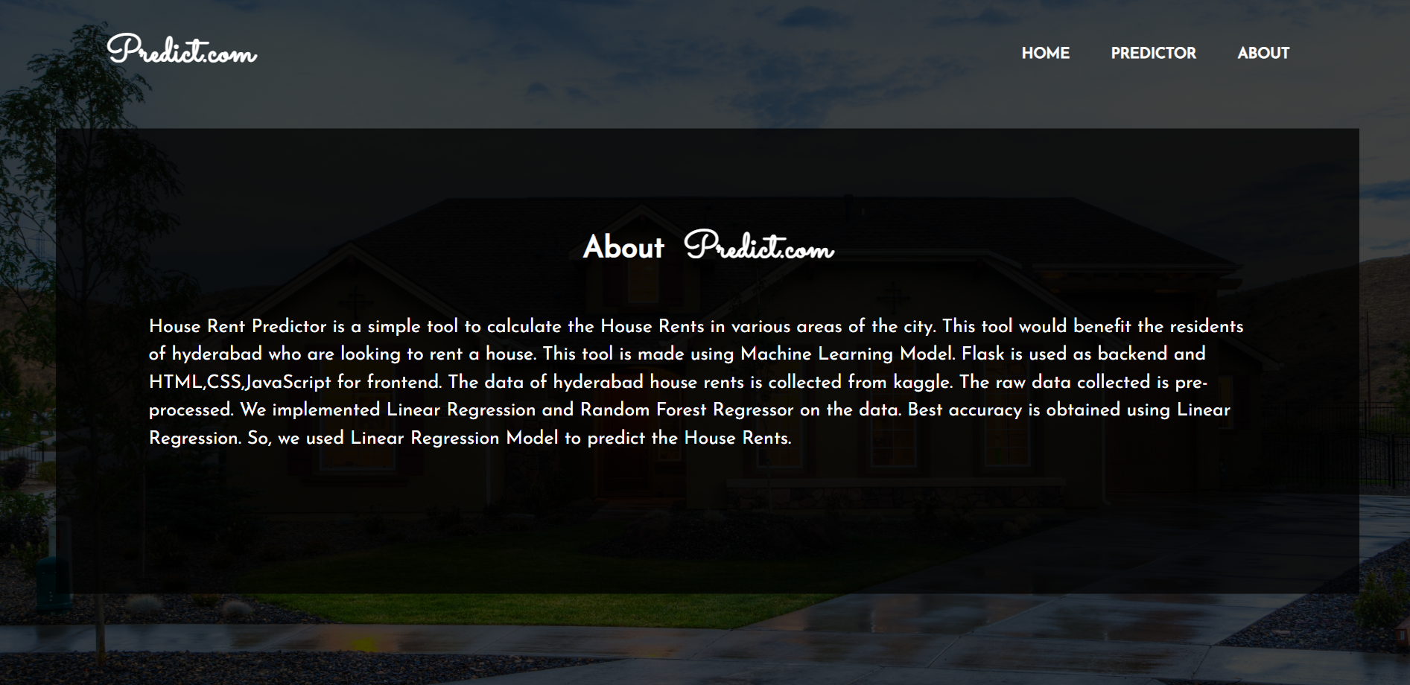
Results and Discussion

Slide 16
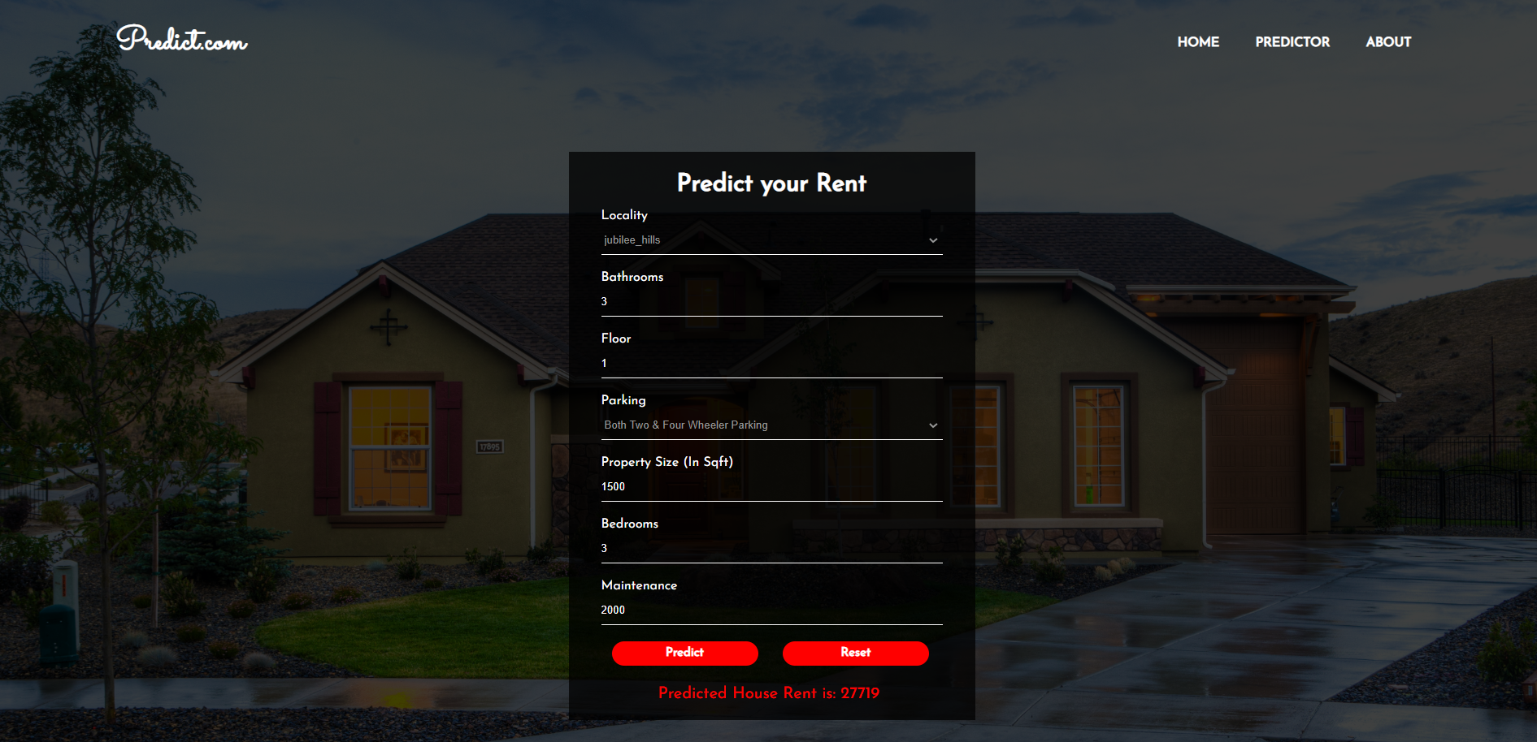
Results and Discussion

Slide 17
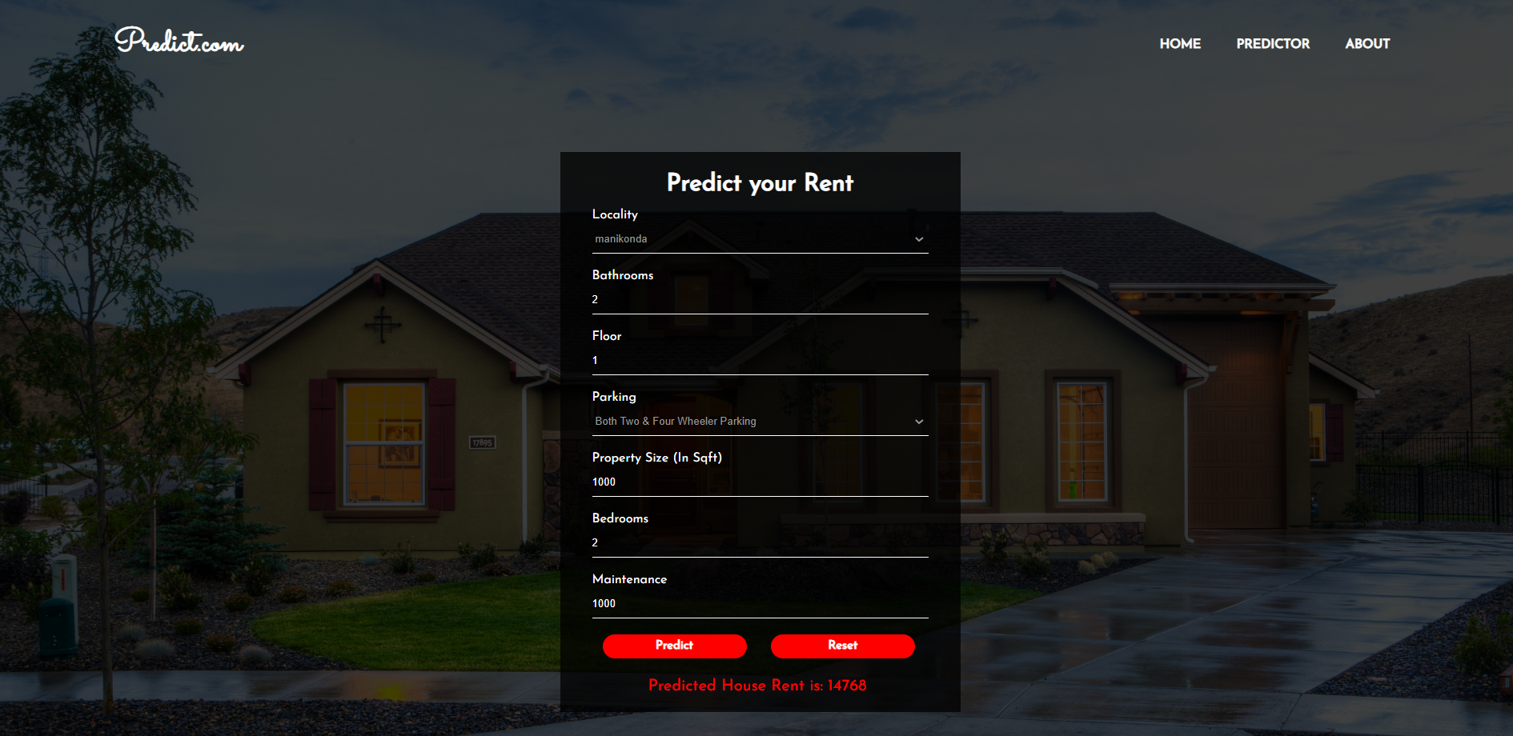
Results and Discussion

Slide 18
Analysis and Interpretation of Results
Inference from the Analysis:-
Accuracy of Linear Regression Model: 86.5%
Accuracy of Random Forest Model: 85.3%
Predicted House Rent for Jubilee Hills area with 3 bathrooms, 1st floor, both 2 & 4 wheeler parking, 1500 Sqft, 3 bedrooms, 2000 maintenance cost is: 27,719
Predicted House Rent for Manikonda area with 2 bathrooms, 1st floor, both 2 & 4 wheeler parking, 1000 Sqft, 2 bedrooms, 1000 maintenance cost is: 14,768

Slide 19
Conclusion
We implemented Linear Regression and Random Forest algorithms in this project. On this dataset, Linear Regression performed well.
As the result of Prediction, we can conclude that Locality of the house and Property Size plays a major role in deciding the house rent.
Also, increase in number of bedrooms increases the rent of the house.
Parking and Floor have less impact on the house rent.

Slide 20
Conclusion
Future Work:
In this Project, we had applied only Linear Regression and Random Forest Algorithms. We can apply more algorithms and can create a better Predictive Model.
we have taken only the data of Hyderabad city. In future we can take data of many other cities will which help users from many locations to predict house rents.

Slide 21
References
[1] Documentation and User Guides of Modules used in this project:
Python: https://docs.python.org/3.9/
Numpy : https://numpy.org/doc/stable/numpy-user.pdf
Pandas : https://pandas.pydata.org/docs/user_guide/index.html#user-guide
Matplotlib : https://matplotlib.org/stable/tutorials/index.html
Scikit-learn:
https://scikit-learn.org/stable/modules/generated/sklearn.linear_model.LinearRegression.html
https://scikit-learn.org/stable/modules/generated/sklearn.ensemble.RandomForestClassifier.html
Flask: https://flask.palletsprojects.com/en/2.1.x/
[3] YouTube Tutorials :
Data Visualization Tutorials:
https://www.youtube.com/watch?v=CmorAWRsCAw&list=PLeo1K3hjS3uuASpe-1LjfG5f14Bnozjwy
https://www.youtube.com/watch?v=rN0TREj8G7U&list=PLUcmakntVocWGSKXIsUn1J7Wm9ekpZ87G
https://www.youtube.com/watch?v=E5RjzSK0fvY
https://www.youtube.com/watch?v=ok2s1vV9XW0
https://www.youtube.com/watch?v=Z1RJmh_OqeA

